Slide 1

Networking Day 2
The Handsome Seastars

Slide 2
RADIUS
Remote Authentication Dial-In User Service

Slide 3
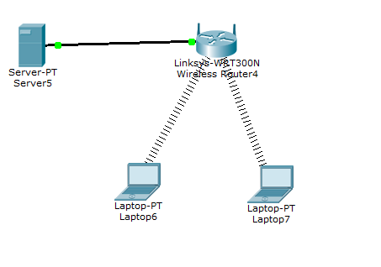
Device Setup
Start by placing 2 laptops, a wireless router, and a server in this formation and connect the Server’s Ethernet port and the Wireless router with a copper straight through cable. They will connect automatically

Slide 4
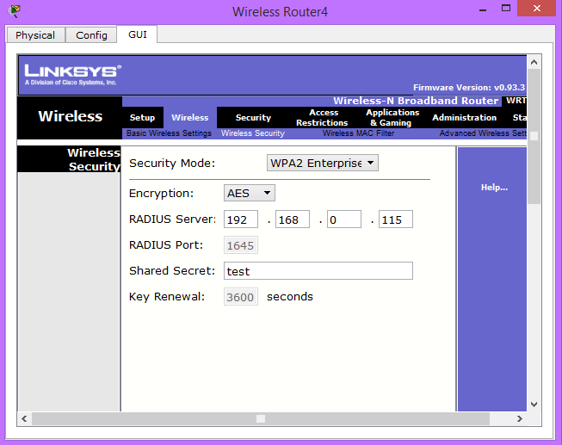
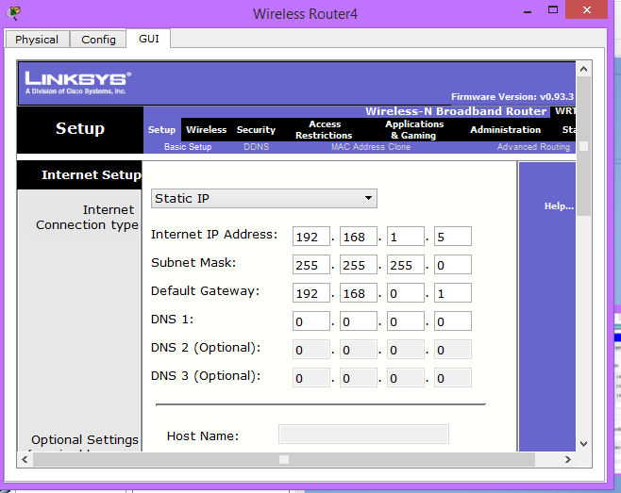
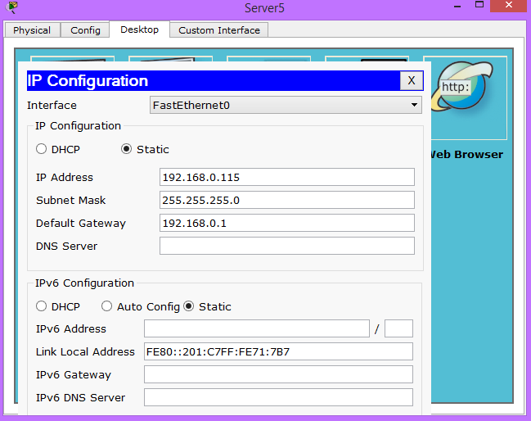
Setting Up Router
Next configure the wireless router and server to have the following information

Slide 5
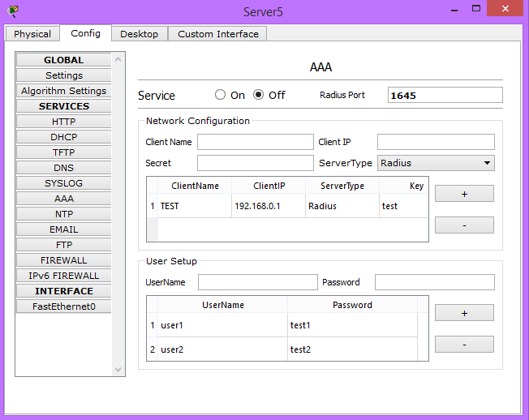
RADIUS Server Setup
Next configure the RADIUS Server to have the appropriate network configuration and Use Setup
Add 2 accounts for User Setup, one for each laptop

Slide 6
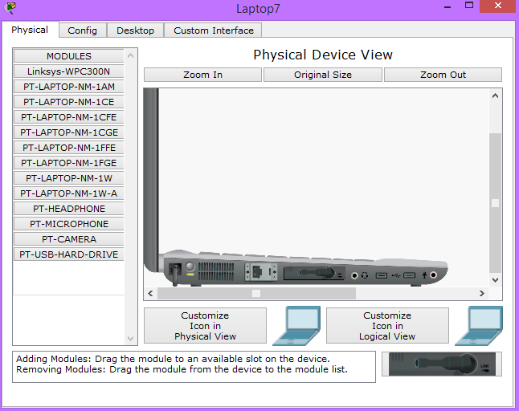
Setting up the laptops
Next install a wireless adapter on the laptops

Slide 7
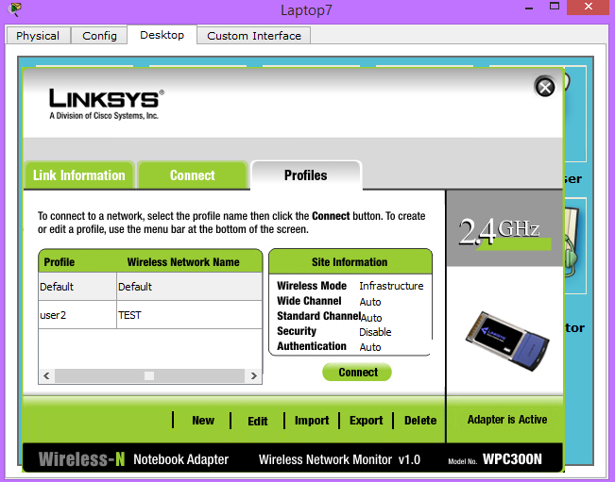
Setting up the laptops
Next go Profiles in Laptop -> Desktop -> PC Wireless -> Profiles
Then select the Default profile and click “Edit”

Slide 8
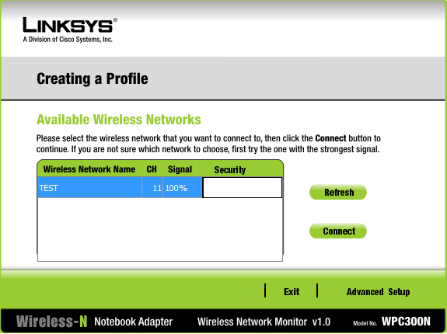
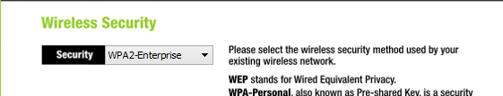
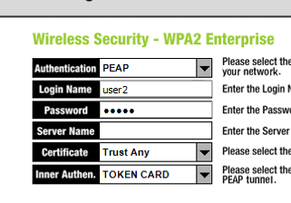
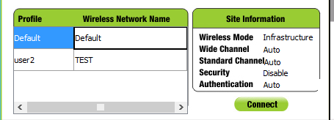
Setting up the laptops
First select the Network of your RADIUS and click Advanced Setup
Next through the screens until you can select WPA2-Enterprise as the Wireless Security. Then enter the Login Name and Password from the Radius. Once you are finished, save the changes. And click the network and press “Connect”

Slide 9
VoIP
The Handsome Seastars

Slide 10

VOIP: what is it?
Voice Over Internet Protocol
AKA internet telephony, broadband telephony...
Delivers voice and media over IP networks
Consumer uses: Skype, TeamSpeak, Xbox Live...
For business: MagicJack, Vonage, other internet phone services

Slide 11
A little bit of history
Originated in 1995
(Relative) improvements in the Internet
Hobbyists wanted to avoid long-distance charges
Entirely computer-based
Poor sound quality
2000s: VOIP took off
Internet improved; special equipment bridges public phone and VOIP
Enterprises adopt on large scale

Slide 12
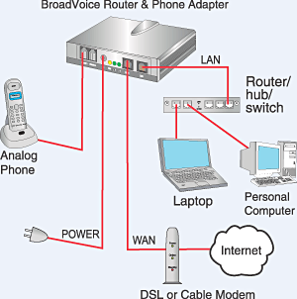
An example of a home VoIP network
Companies simplified establishment of VoIP in the home:
Dedicated phones can “plug-and-play”
Analog telephone adapters bridge analog phones with the Internet through a special phone jack
Softphones are computers with software and a “soft” dialpad to interface with the network
Software like Skype

Slide 13
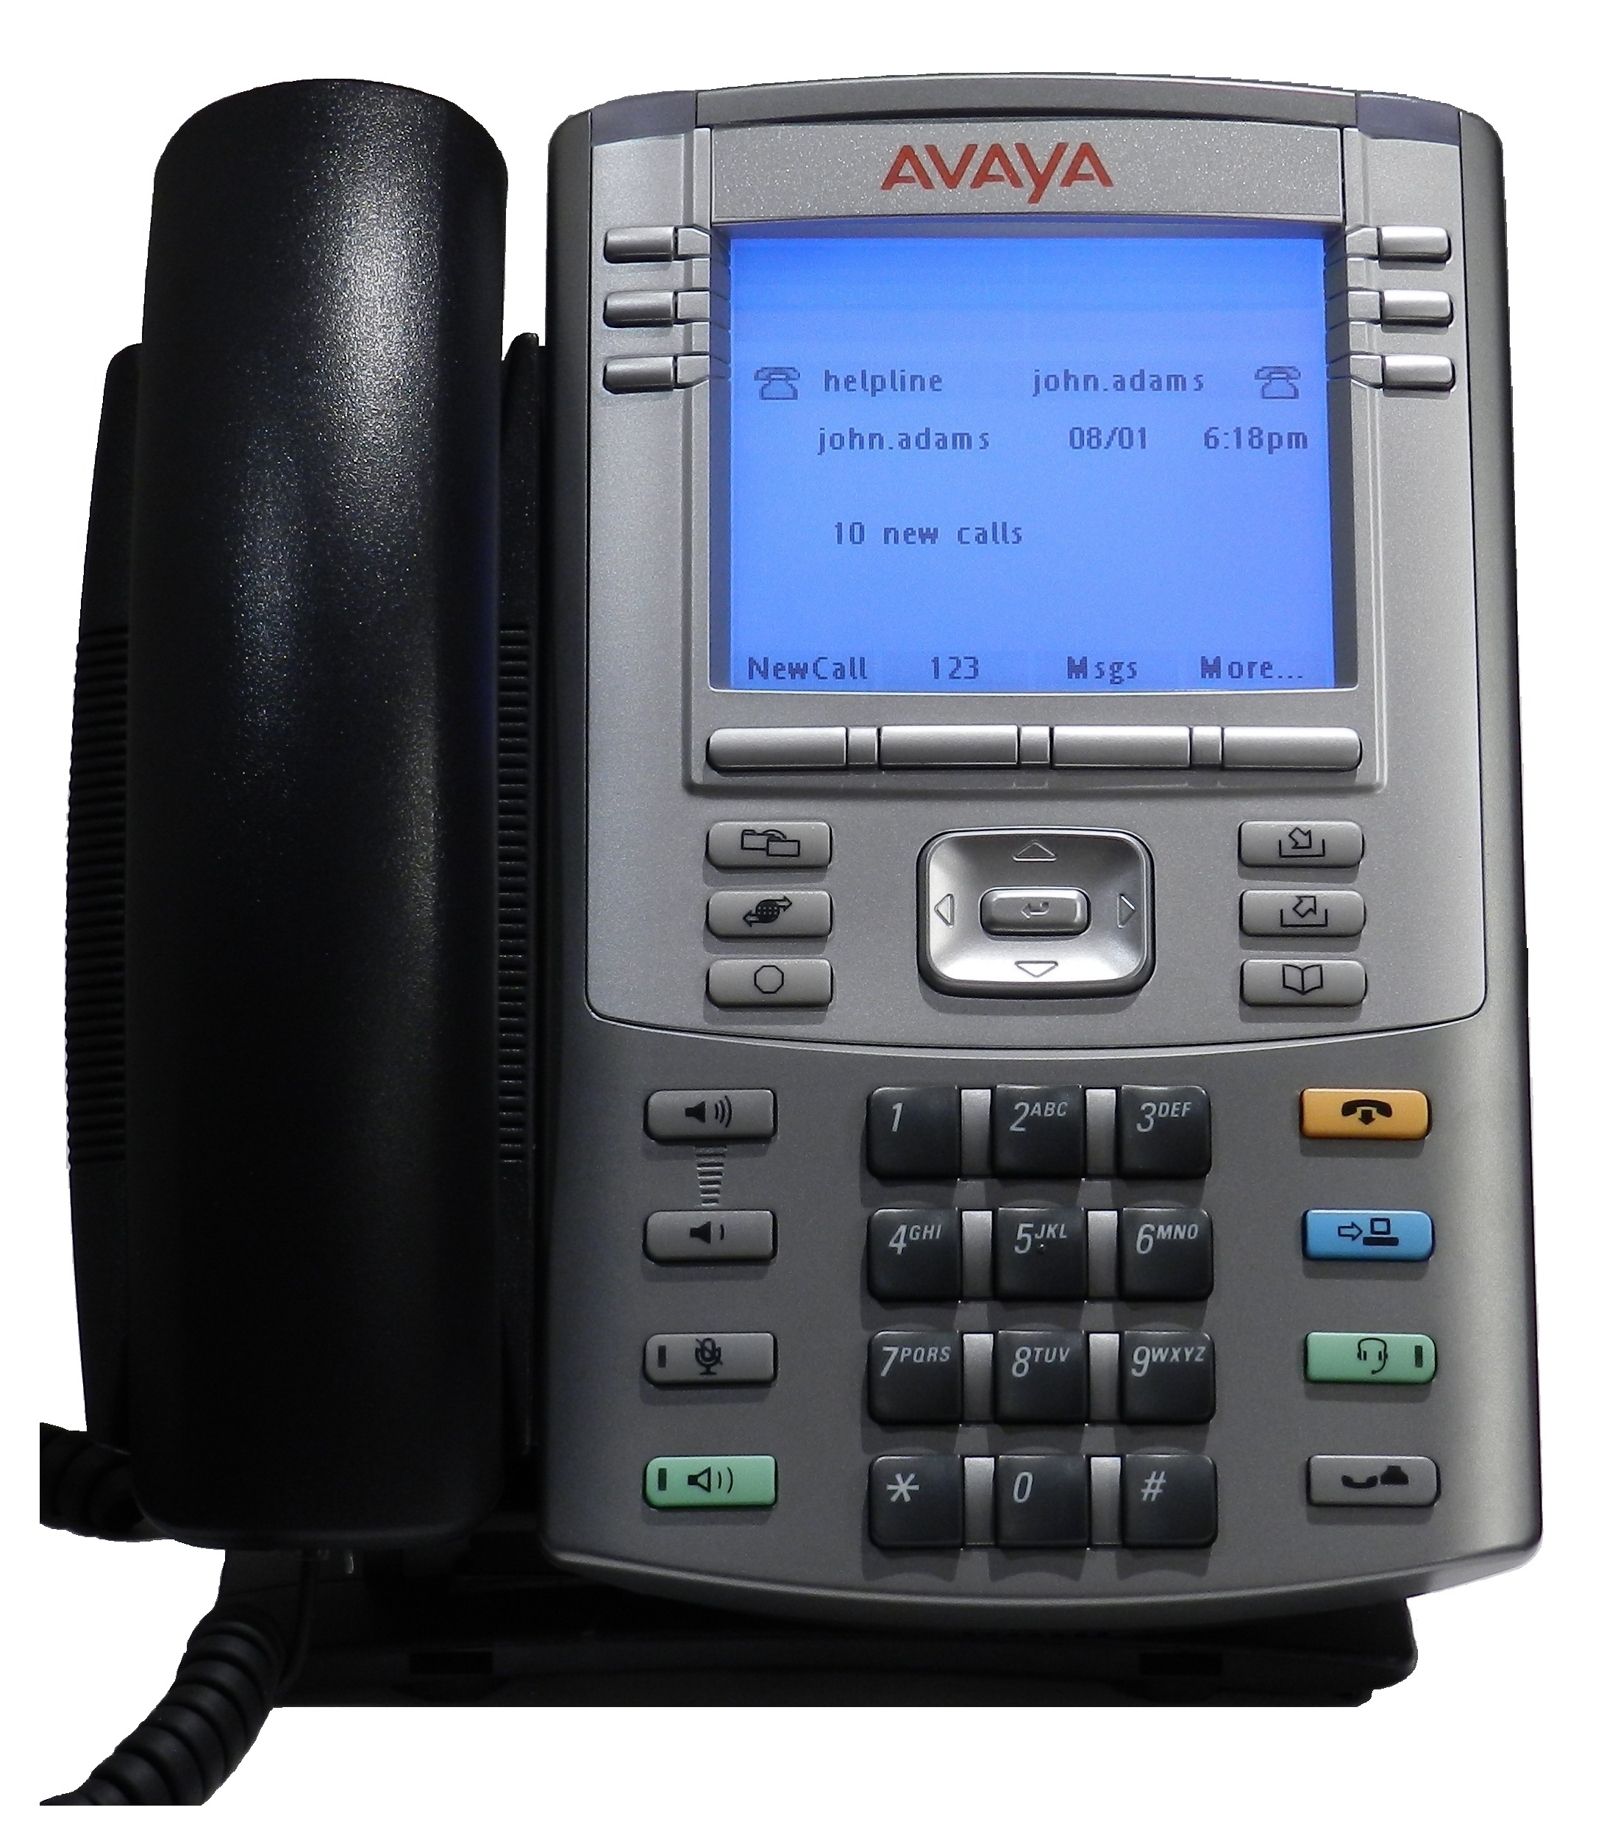
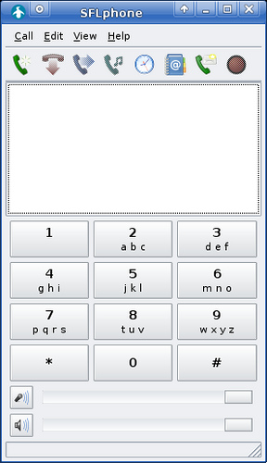
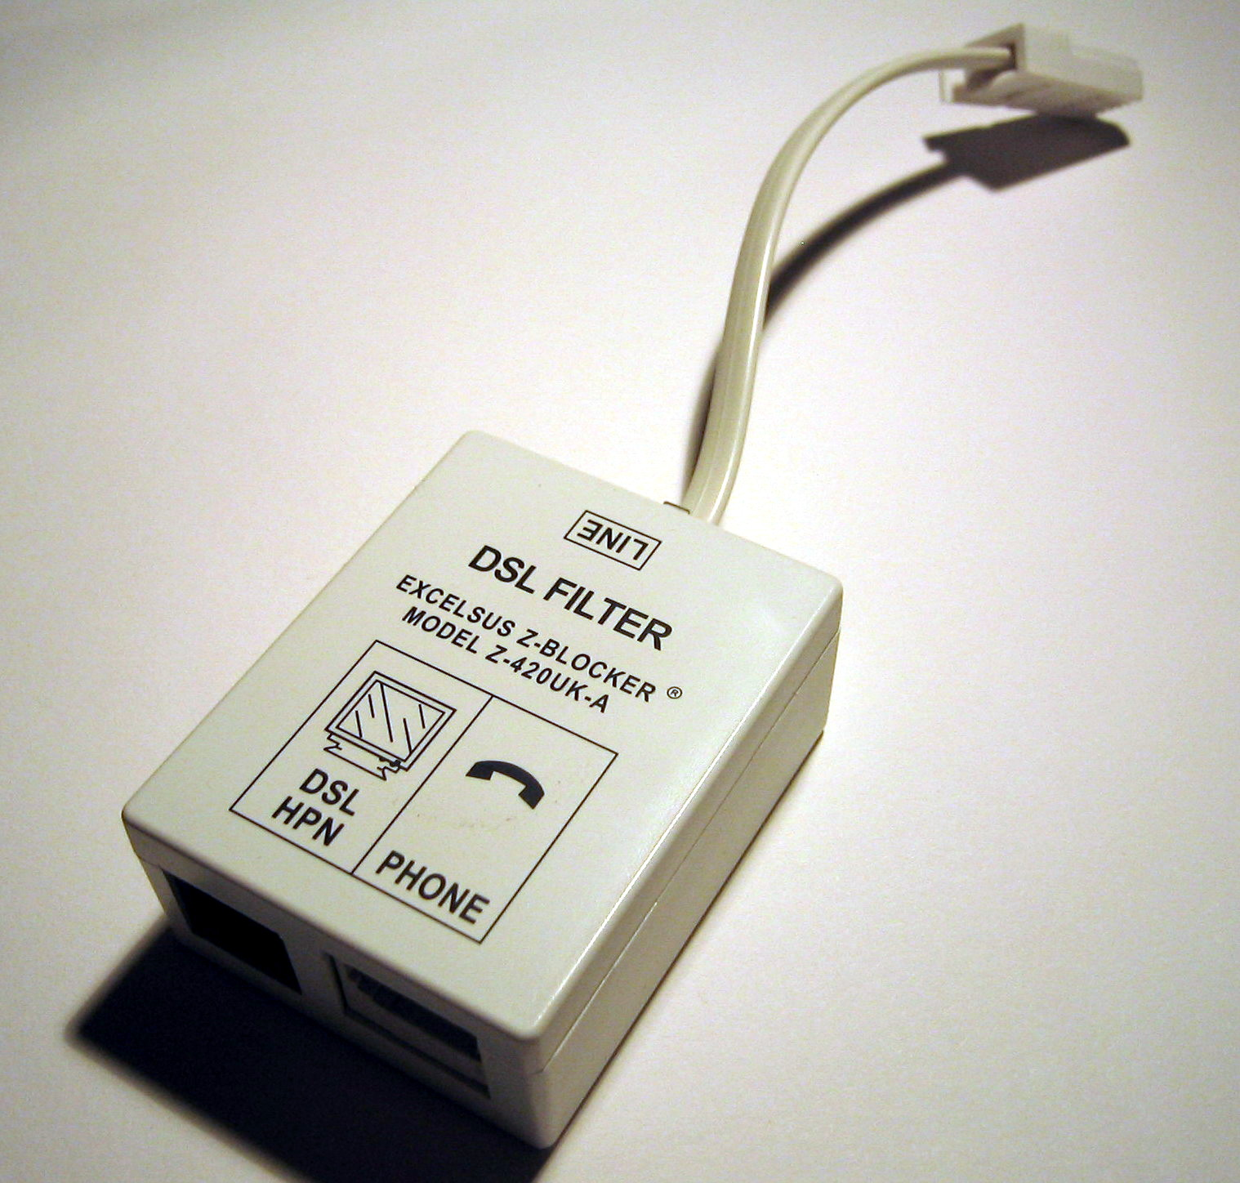
Solutions in pictures

Slide 14
VOIP: how’s it different?
Besides relying on IP packets rather than circuit switching, VoIP calls actually similar to traditional digital calls
Session control, just like we know it
Channel setup
Processing + digitization of analog voice signals
Encoding w/ special audio codecs
Low data usage possible through compression → low audio quality. Depends on your requirements
Narrowband and wideband codecs
Example: Speex

Slide 15
VOIP Protocols
Be on the lookout for these in Wireshark!
Both proprietary and open-source variants exist.
Session Control
Session Initiation Protocol (SIP) -- handles initiation of VoIP sessions
Session Description Protocol (SDP) -- handles negotiation between parties of VoIP sessions
Media Gateway Control Protocol (MGCP) -- bridges gateways between VoIP network and public telephone network
Audio Transport Management
Real-time Transport [Control] Protocol (RT[C]P)
Secure Real-time Transport Protocol (SRTP) + MIKEY key management
Standardized Specifications
H.248
H.323

Slide 16
Potential issues with VOIP
If a client ever asks you to set up a VoIP network, be aware of these issues first:
IP doesn’t natively provide QoS
VoIP packets have same priority as all others
Latency, packet loss, jitter (deviation from true periodicity of a periodic signal)
Packets must be sent sequentially for smooth audio, but UDP used to reduce latency
Resequencing must be done by receiver
Compromises between lag & audio drop-out
Congestion on non-robust networks
Increase overall network susceptibility to DoS
Network must be reasonably fast
Not great for rural areas ex. cellular data used → expensive
E911 can cost $$$, depends on your data to know where you are in an emergency
Keep it up to date!
Easy to spoof Caller ID → your organization vulnerable to social engineering

Slide 17
More considerations
Telephones, PBX servers, network equipment can be hacked
MitM and thus eavesdropping possible, as always
IPsec and encryption take valuable time
Leads to drop in QoS, even with speedy engines like AES
Not yet entirely compatible with NAT
Increases packet sizes
Solution cIPsec (compressed); but this puts more CPU strain on receiver
Bad for mobile devices, low-end phones
Potential bottleneck, even on 100Mbps link
Even now, still an emerging technology -- not fully standardized

Slide 18
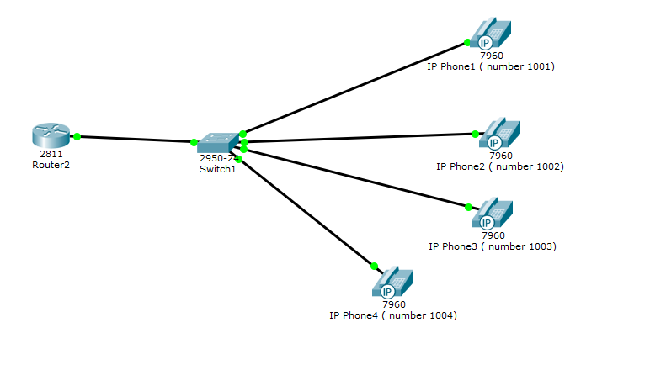
Basic Network
Lab

Slide 19
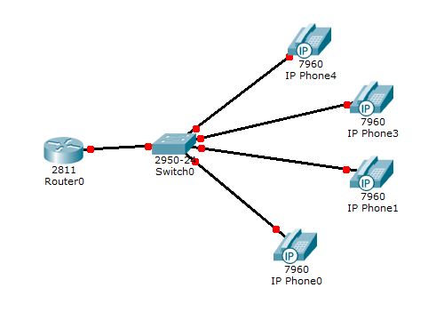
Basic Network

Slide 20
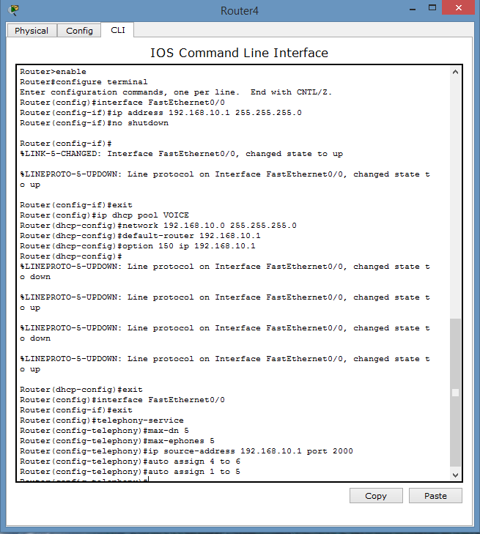
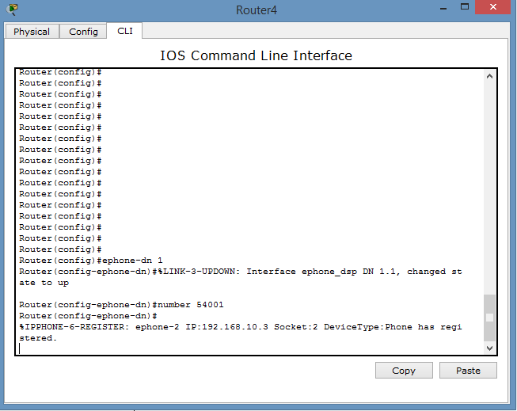
Basic Network

Slide 21
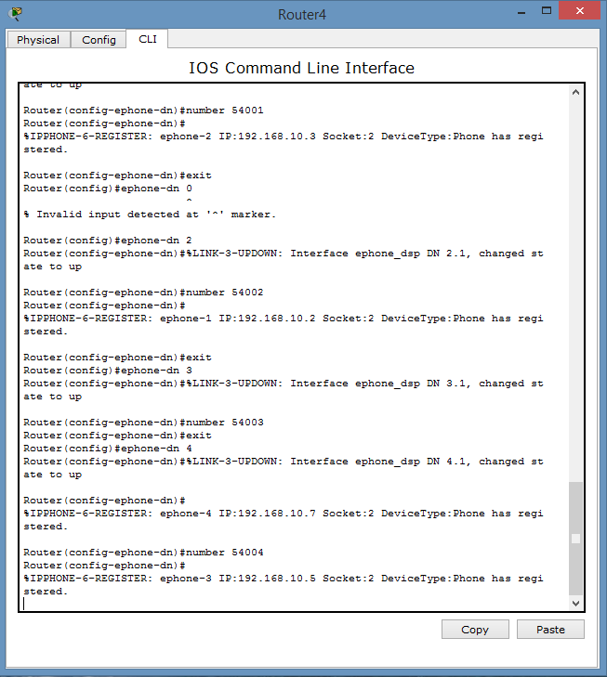
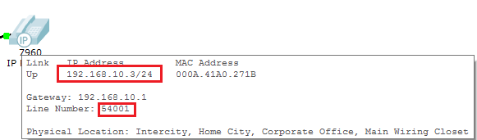
Basic Network

Slide 22
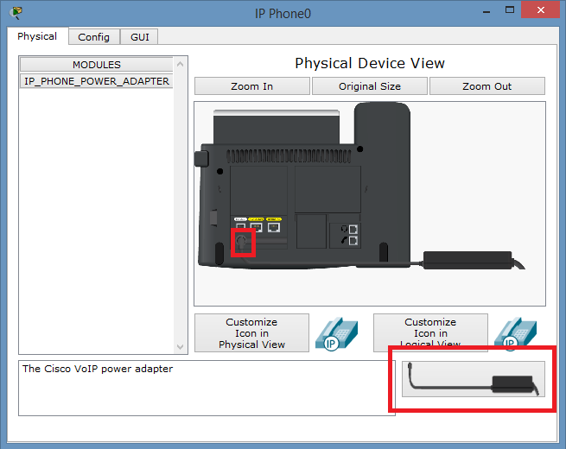
Basic Network

Slide 23
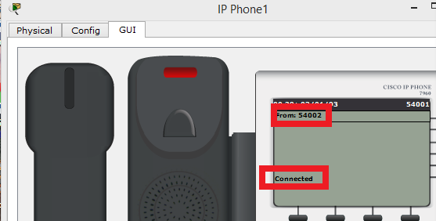
Basic Network

Slide 24
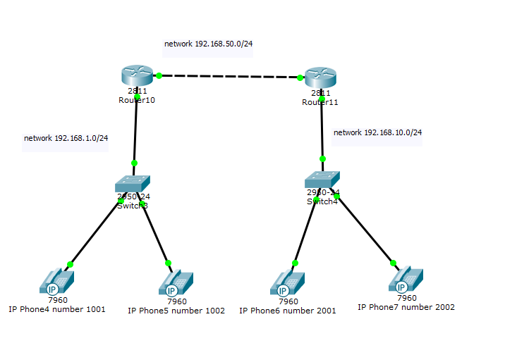
Advanced Network
Lab

Slide 25
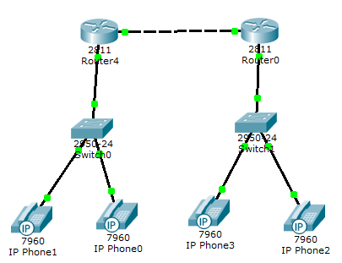
Advanced Network

Slide 26
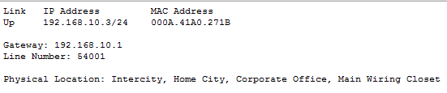
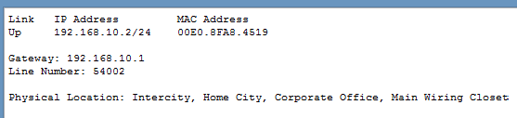
Advanced Network

Slide 27
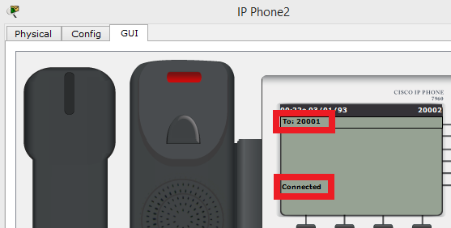
Advanced Network

Slide 28
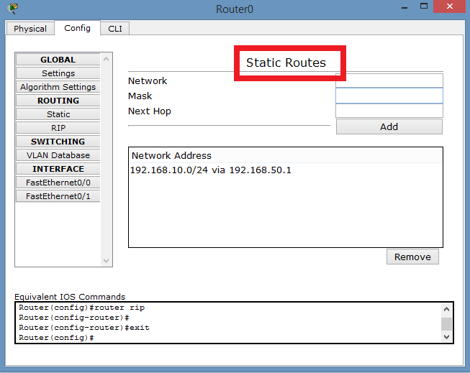
Advanced Network

Slide 29
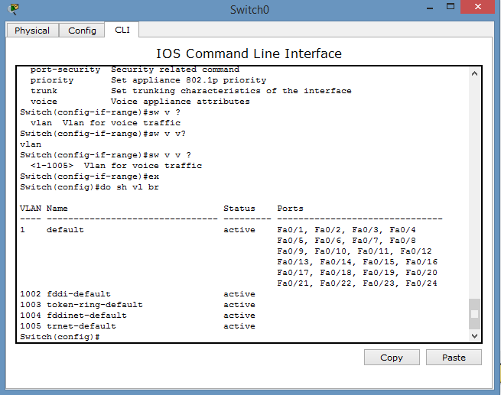
Advanced Network
Set Vlan to Voice

Slide 30
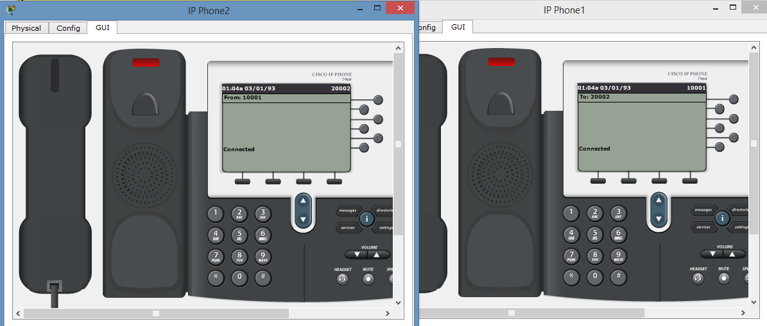
Advanced Network

Slide 31
VPN
Virtual Private Network

Slide 32
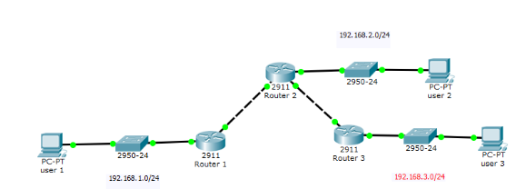
Initial Configuration

Slide 33
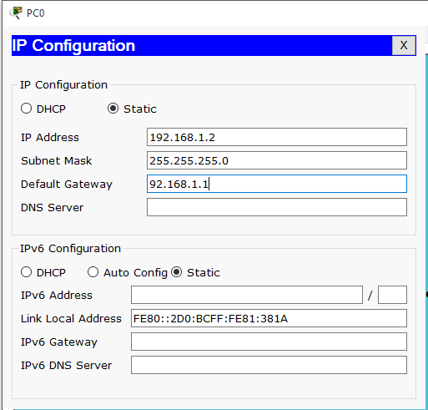
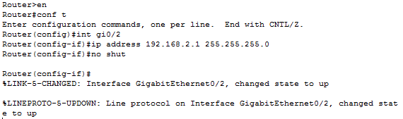
Configure IPs
Configure the PC and Router IPs just like last time

Slide 34

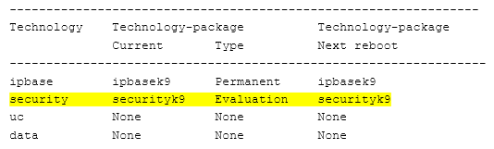
Enable Security Features
To activate the securityk9 module
Confirm with show version

Slide 35
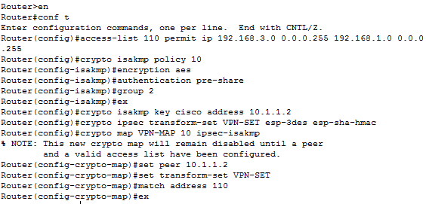
Configure IPsec Parameters on R1 and R3
Configure ACL 110 to identify the traffic from the LAN on R1 to the LAN on R3 as interesting. This interesting traffic will trigger the IPsec VPN to be implemented whenever there is traffic between R1 to R3 LANs. All other traffic sourced from the LANs will not be encrypted
Configure the crypto ISAKMP policy 10 properties on R1 along with the shared crypto key cisco (ISAKMP (Internet Security Association and Key Management Protocol) is a protocol defined by RFC 2408 for establishing Security Associations (SA) and cryptographic keys in an Internet environment.)
Create the transform- set VPN-SET to use esp-3des and esp- sha-hmac. Then create the crypto map VPN-MAP that binds all of the Phase 2 parameters together. Use sequence number 10 and identify it as an ipsec-isakmp map.
Finally, bind the VPN-MAP crypto map to the outgoing Serial 0/0/0 interface

Slide 36
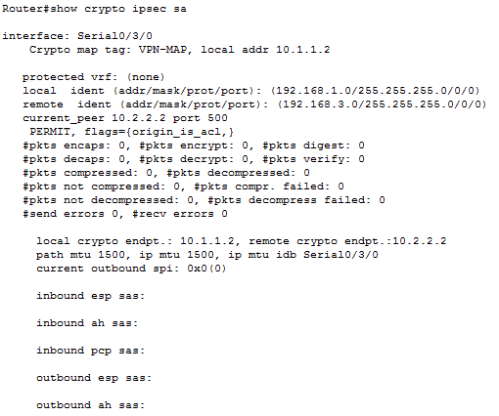
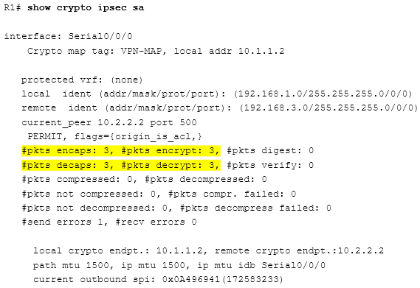
Verify the IPsec VPN
Use the show crypto ipsec sa command and notice that there are no packets. First we create interesting traffic by pinging PC3 from PC1. Now we have packets. Then we create uninteresting traffic by pinging PC2 from PC1. And we notice that number of packets remained the same. Hence the traffic was only encrypted through the VPN which is what we want

Slide 37
Sources
http://csrc.nist.gov/publications/nistpubs/800-58/SP800-58-final.pdf
https://courses.cs.ut.ee/MTAT.08.004/2015_spring/uploads/Main/37_1.pdf

